Slide 1



ALTEN Calsoft Labs
Company Introduction

Slide 2



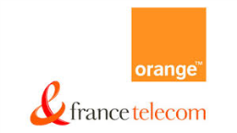

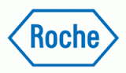

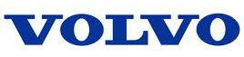

ALTEN Group
ALTEN Group is a French multinational company with a global footprint and Euro 1.4 Billion revenue.
It is one of the world’s largest engineering and technology consulting companies with operations in 20 countries and an employee base of almost 20,000 people.
ALTEN helps some of the world’s biggest companies with their R&D and IT projects.
ALTEN is focused on 5 major industry segments:
Aerospace & Defence, e.g. EADS Group, Thales, Safran, etc.
Transportation, e.g. Volvo, Volkswagen, Alstom, Renault, etc.
Telecom, e.g. Alcatel, Ericsson, France Telecom, Telefonica, etc.
Energy & Life sciences, e.g. Total, Areva, GE, Roche Group, etc.
Financial & Related markets, e.g. Societe Generale, BNP Paribas, Barclays, AXA, Amadeus, etc.
ALTEN Group started operations in India in 2009 and it is growing its footprint in India at a fast pace.
Leading European Engineering & Technology Consulting Group
Set up in 1988, HQ in Paris, Publicly listed [Euronext: ATE]
ALTEN helps some of the world's biggest companies with their R&D and Information systems projects
€1,373
MILLION REVENUE
55% France, 45% Overseas
PRESENT IN
20 COUNTRIES,
31% International Growth
18,400
EMPLOYEES
88% Engineers
Track record of working with leading global customers for over 25 years
Key Customers
2

Slide 3
ALTEN Calsoft Labs
Product Engineering and IT Services arm of the ALTEN Group
Founded in 1992 | Head quartered in Silicon Valley, USA | Acquired by ALTEN Group in 2011 | Over 1200 employees
Focus on leveraging disruptive technologies to solve business challenges for customers
Core Service areas
Consulting
Product Engineering Services
Enterprise IT Services
Provides complete Product Life cycle Services from “Chip” to “Cloud”
Strong domain experience in Education, Healthcare, ISV, Retail, Networking and High-tech markets
3 locations in India (Bangalore, Chennai, Mysore)
Industry leading customers in addressed market segments; Several 10+ year old relationships
Niche player with Expert resources in emerging Cloud Infrastructure and Digital Transformation solutions
Part of ALTEN’s global workforce | Center of Excellence within ALTEN Group for Embedded, SDN/NFV and SMAC technologies
ALTEN Calsoft Labs started operations in 1992 as California Software Company with HQ in Silicon Valley and excellent business footprint in the US market.
ALTEN Group acquired Calsoft Labs in 2011 as part of its strategy to grow its operations in India and USA. Since then, Calsoft Labs has grown from 600 employees to 1500 employees across India and USA and we expect to continue growing at 20-30% every year.
Calsoft Labs has always been focused on emerging technologies. We see ourselves as a niche player focusing on disruptive technologies like SMAC (Social-Mobility-Analytics-Cloud) and Cloud Infrastructure to conceptualize and build products/solutions for our customers.
We have 3 service lines in our portfolio:
Consulting Services (Technology consulting / Process consulting)
Product R&D Services (Product Development for OEMs/ISVs)
Enterprise IT Services (Enterprise Application Development to help companies make the transition to the Digital economy)
Calsoft Labs has strong domain expertise in Education, Healthcare, High-Tech, ISV, Networking and Retail markets. We work with industry leaders in each of these markets. Many of our customers have been working with us for over 10 years.
3

Slide 4
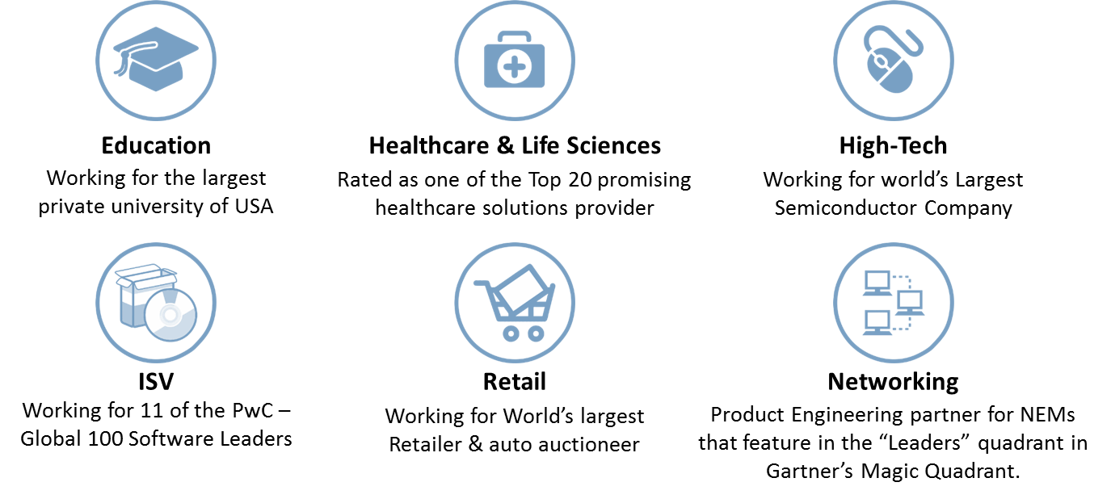
Our Industry Segments
ALTEN Calsoft Labs we work with industry leaders in each of the industry segments where we are present. For example,
In Education we work with the largest private university in the world.
In Healthcare we work with key players in Hospital Information Systems, EHR/EMR, Collaborative Care management and Digital Healthcare
In High-Tech we work with 2 of the world’s largest semiconductor companies and several OEMs developing innovative products for consumer and industrial use.
In Networking we have a long history of working on products that have featured as leaders in Gartner Magic Quadrant.
Today Calsoft Labs is known in the market as pioneers in the emerging SDN & NFV space with several industry first projects.
In Retail, we work with the world’s largest retailer and world’s largest auto auctioneer. We are also helping several major US based retailers like GAP, Macys, etc. in their Agile Transformation journey through our subsidiary cPrime in USA.
In case of ISVs (Independent Software Vendors) we work with 11 of the Global-100 Software Leaders, apart from Social Networking giants like Facebook and Paypal.

Slide 5



Our Service Offerings
Consulting
IT Services
Product Engineering Services
Agile Process consulting
IT Consulting
Operations Consulting
Technology Consulting
Agile ADMS
Cloud Enablement
Infrastructure Management
Application Integration
Legacy Modernization
IT Service Management
Product Development
Product Testing
Product Maintenance & Support
Product Reengineering
SaaS Enablement
Mobility Enablement

Slide 6






Our Centers of Excellence are Foundations of Our Delivery Organizations
Calsoft Labs has always been focused on emerging technologies. We see ourselves as a niche player focusing on disruptive technologies like SMAC (Social-Mobility-Analytics-Cloud) and Cloud Infrastructure to conceptualize and build products/solutions for our customers.
Therefore we consistently focus on investing on new technologies ahead of time by setting up technology Centers of Excellence (CoEs). These CoEs build capability on latest technologies through internal projects and customer engagements.
Some of the prominent CoEs are;
SDN/NFV focusing on latest development in Networking and Cloud infrastructure space.
Embedded Systems focusing on emerging technologies in IoT (Internet of Things) and energy efficient product/system design for consumer and industrial use.
Open Source is the new mantra in the IT industry. We have a focused Java and Open Source CoE that builds competencies on latest open source frameworks and tools to help customers reduce R&D costs or reduce cost of IT.
Our Testing CoE helps customers improve their testing process, and offers test automation frameworks and test assets to help customers reduce their testing cycle time in projects.
SDN/NFV
Embedded Systems
Open Source
Microsoft Technology
UX Engineering
Testing
User Experience (UX) is a key differentiator for Calsoft Labs. We are one of the few companies that has the ability to design UX across multiple devices (PC/tab/mobile) used by users of an application/product, and build responsive UIs using latest technologies.
Our Microsoft CoE focuses on latest Microsoft technologies including Azure services. Calsoft Labs is an Microsoft Azure Circle partner.

Slide 7
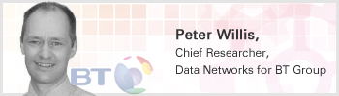
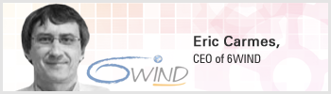
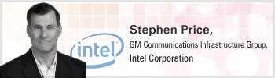
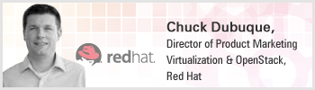
Industry References
“Calsoft Labs have demonstrated world class knowledge of networks and leading edge packet processing software. They delivered a compelling, scalable, low power, compact, high performance solution running on standard x86 servers in only a few months to BT.”
“Calsoft Labs has relevant expertise as a system integrator and our partner in the Telecom market, we look forward to working with Calsoft Labs on NFV opportunities.”
“Calsoft Labs has been among the early leaders in NFV, bringing network operators increased flexibility and value as they move to the cloud, and we're pleased that they've selected Red Hat Enterprise OpenStack Linux Platform for their highly scalable NFV platform and as an open foundation for a heterogeneous cloud environment.”
“Intel is pleased to see Calsoft Labs supporting Intel DPDK customers to develop and roll out new and enhanced products and services, and accelerate revenue streams.“
7

Slide 8
Thank You

